Slide 1

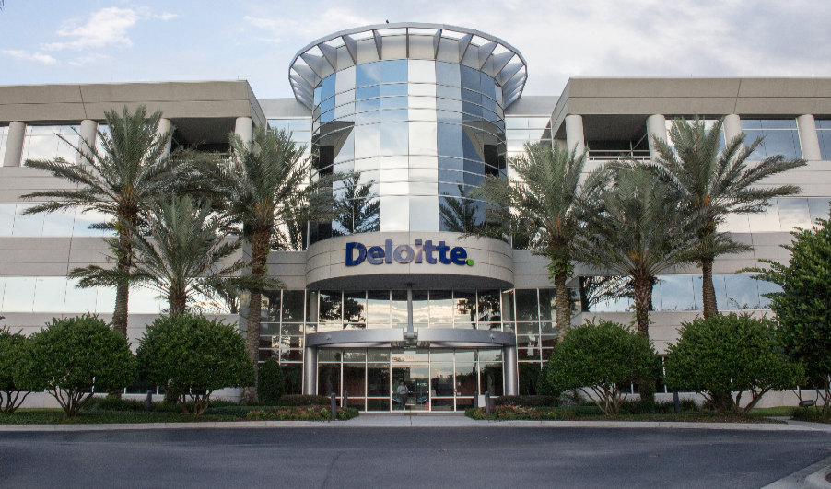
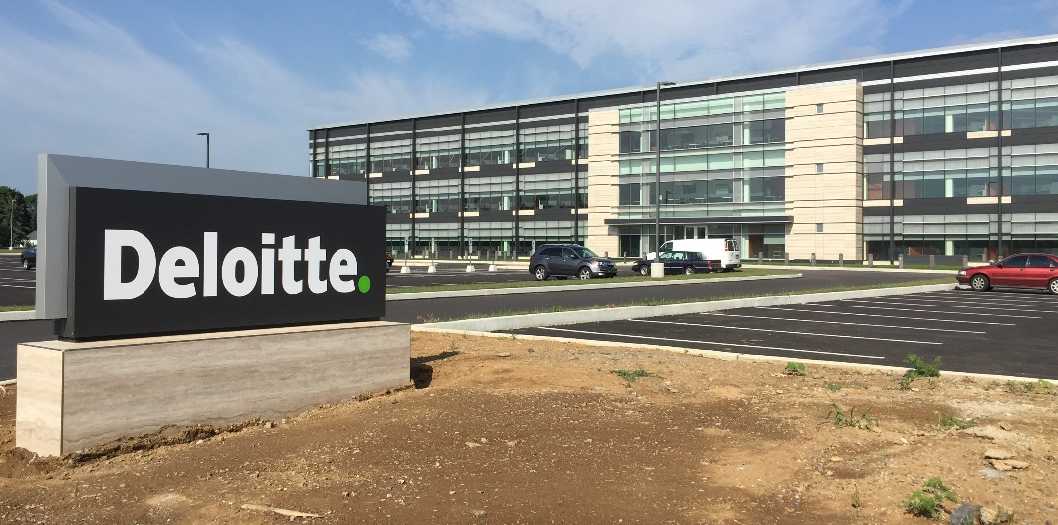

USDC Information Technology Center of Excellence (IT-CoE)
Topic: CompTIA Security+ Testing Review
Orlando, FL
Mechanicsburg, PA
Gilbert, AZ

Slide 2
Threats, Attacks, and Vulnerabilities
Session 2
Security+
CompTIA Security+
Test: SYO-601
EXAM OBJECTIVES (DOMAINS)
The table below lists the domains measured by this examination and the extent to which they are represented:
Domain | Weight
1.0 Threats, Attacks and Vulnerabilities | 24%
2.0 Architecture and Design | 21%
3.0 Implementation | 25%
4.0 Operations and Incident Response | 16%
5.0 Governance, Risk, and Compliance | 14%
Total | 100%
Session 2
Includes Objectives from Domain 1
Objective 1.2 – Given a scenario, analyze potential indicators of compromise and determine the type of malware.
Objective 1.4 – Given a scenario, analyze potential indicators associated with network attacks.

Slide 3


Threats, Attacks, and Vulnerabilities
Session 2
Security+
Friday 04/02/2021
Conti ransomware gang hits Broward County Schools with $40M demand.
The Conti ransomware gang encrypted the systems at Broward County Public Schools several weeks ago and threatened to release sensitive student, teacher and employee personal data unless the district paid an enormous $40 million ransom.
Saturday 04/03/2021
Facebook Data for 533 Million Users Online for Free.
The leak includes personal information on 533 million Facebook users, such as phone numbers, Facebook IDs, full names, locations, birth dates, bios and in some cases email addresses.

Slide 4
Threats, Attacks, and Vulnerabilities
Session 2
Security+
Terminology
ARP Spoofing – Also known as ARP poisoning, this is an attack on Level 2 device that spoofs or fakes the MAC address of a device on the network to direct traffic to the attacker’s device.
Attack – Any unauthorized intrusion into the normal operations of a computer or network. The attack is meant to gain access to the system or any of its resources.
Denial-of-Service (DoS) – A type of attack that prevents any users, including valid legitimate users, from being able to access and use a system.
Logic Bomb – Any code that is hidden within an application that causes something malicious within the system based on some criteria being met. This malicious code may be triggered to delete files after six months if a disgruntled programmer is fired.
Man-in-the-Middle – An attack that occurs when network packets from a network device is intercepted by an attacker, and then re-transmitted to another network device, with the packets possibly being changed, but at least captured and recorded by the attacker.

Slide 5
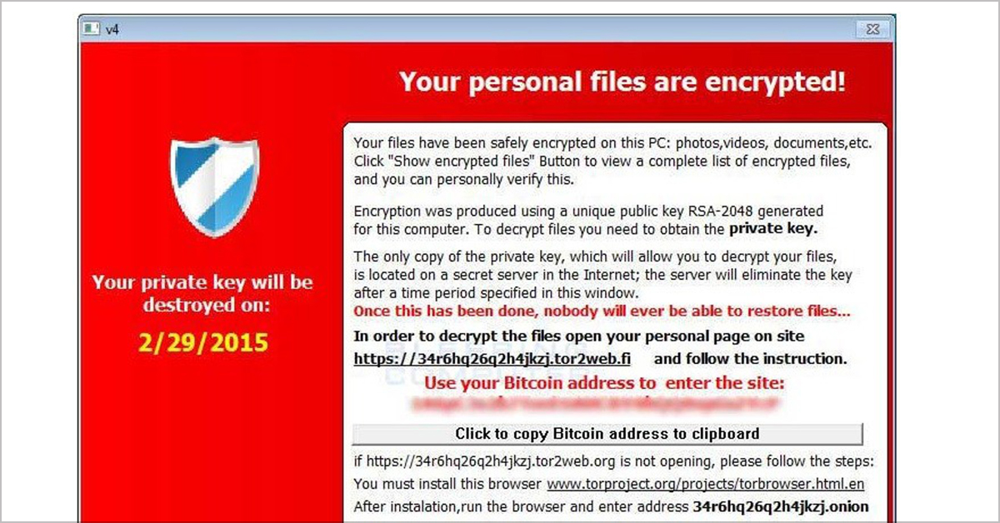
Threats, Attacks, and Vulnerabilities
Session 2
Security+
Malware and Crypto-Malware
Ransomware
Software delivered by a Trojan, takes control of a system and demands that money be paid to release control of the system.
The typical method is to encrypt the entire hard drive of the system and offer the decryption key to the end user for a fee.
Organized crime or state actors use ransomware to raise money.
CryptoLocker is the major ransomware virus being used now.

Slide 6
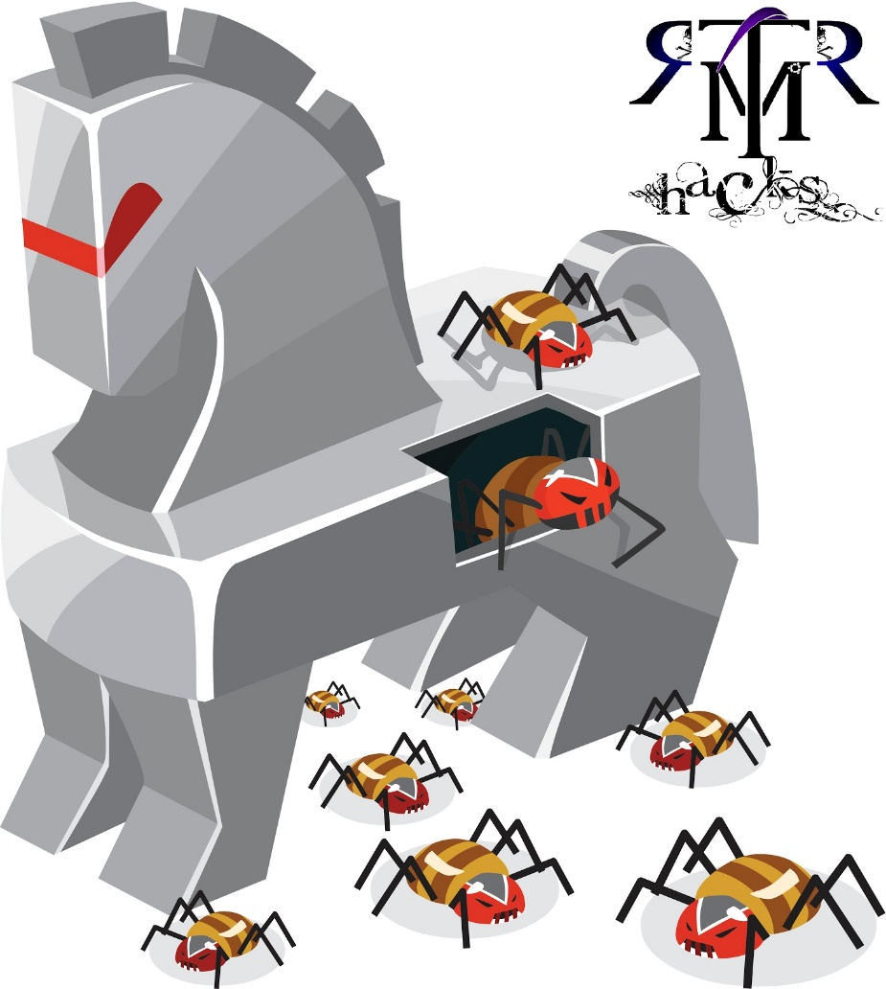
Threats, Attacks, and Vulnerabilities
Session 2
Security+
Malware and Crypto-Malware
Trojan
A program that enters a system or network impersonating another program.
The Trojan Horse may be included as an attachment or part of an installation program. The Trojan could create a backdoor or replace a valid program during installation.

Slide 7
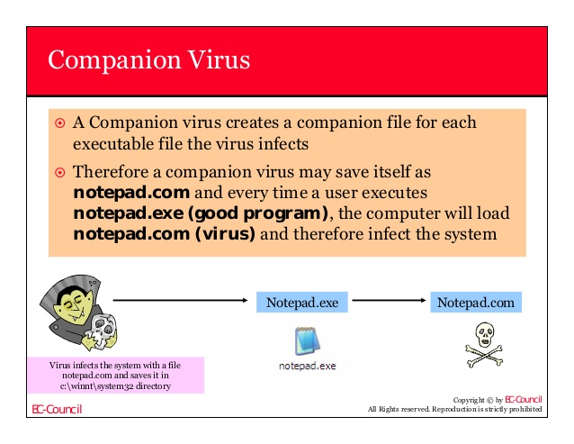
Threats, Attacks, and Vulnerabilities
Session 2
Security+
The World of Viruses
Types of Viruses
Companion Virus – Viruses that attach themselves to legitimate programs and then create a program with a different filename extension. When the user executes the legitimate program, then the companion virus program is executed instead.
Armored Virus – Viruses that cover themselves with protective code to evade detection. The code is written in such a way as to make the tracing, disassembling, and understanding of the code more difficult.

Slide 8
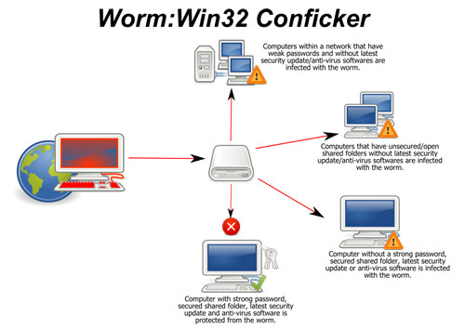
Threats, Attacks, and Vulnerabilities
Session 2
Security+
Malware and Crypto-Malware
Worm
This program’s purpose is to replicate itself on a system, without any user intervention. It will reach out to uninfected systems and spread to those any way possible.
Conficker is a worm that appeared in 2008, infected over 9 million computers all over the world, infecting government, businesses and individuals to create a botnet. One of the largest known worm infections, causing an estimated $9 billion in damage.

Slide 9
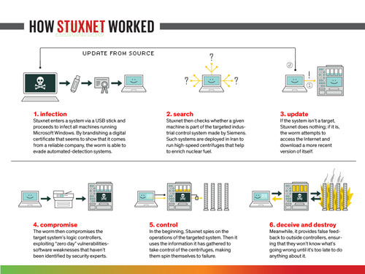
Threats, Attacks, and Vulnerabilities
Session 2
Security+
The World of Viruses
STUXNET
A virus created by the Israeli Defense Force and the US Government (NSA), created for cyberwarfare, intended to disrupt the nuclear efforts of Iran. Revealed in 2010.
Designed to attack Industrial Programmable Logic Controllers (PLC) that control the automation processes in industrial equipment. In this case, by Siemens industrial equipment.
Spread by infected USB drives, it altered the speed of the machines causing the centrifuge to malfunction and tear apart.
Stuxnet contained a worm, a link file, and a rootkit to hide its malicious files and processes

Slide 10
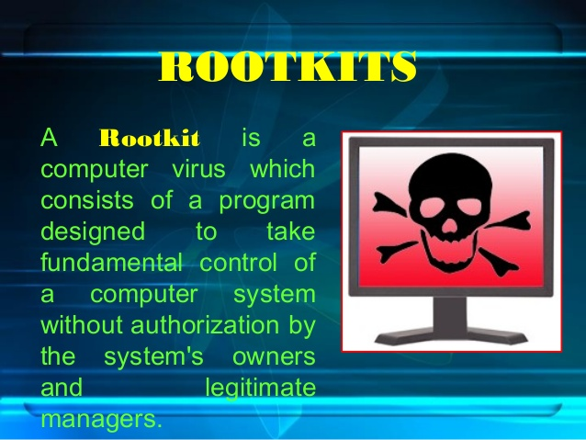
Threats, Attacks, and Vulnerabilities
Session 2
Security+
Malware and Crypto-Malware
Rootkits
Software programs that can hide specific things from the operating system. Processes or services can be running in a system, and they do not show up in the Task Manager display.
The rootkit manipulates function calls to the operating system and modifies the information that would normally appear.

Slide 11
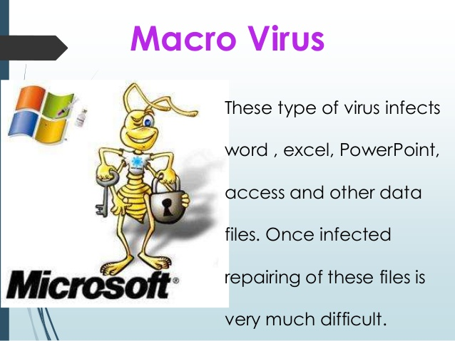
Threats, Attacks, and Vulnerabilities
Session 2
Security+
The World of Viruses
Types of Viruses
Macro Virus – Exploits the underlying interpreted programming language of certain applications, like Microsoft Office products, like Word or Excel that use the VBA language to add functionality to their documents.
Multipartite Virus – Attacks your system in multiple ways. The virus will attack the boot sector, all executable files, and destroy application files. This multi-prong attack then makes it hard to stop.

Slide 12

Threats, Attacks, and Vulnerabilities
Session 2
Security+
The World of Viruses
Types of Viruses
Retrovirus – These virus programs will attack or bypass the installed antivirus program on a computer, trying to destroy the antivirus definition database file. This leaves the computer open to any other viruses to be placed on the computer.
Phage Virus – Will modify host file programs, by modifying the beginning bytes of the executable code, making the executable file corrupt and not able to run. This virus continues to propagate until all of the executable files have been corrupted, making the system crash.

Slide 13
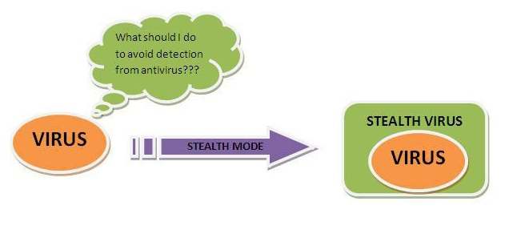
Threats, Attacks, and Vulnerabilities
Session 2
Security+
The World of Viruses
Types of Viruses
Stealth Virus – Attempts to avoid detection by masking itself from other applications.
It may attach itself to the boot sector of the hard drive. If antivirus programs detect the virus, the virus will temporarily move itself away from the infected file and copy itself to another drive and replace the original file that it infected with a clean file.
The Stealth Virus can avoid detection by concealing the size of the file it has infected.

Slide 14
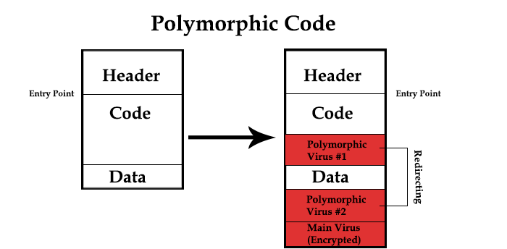
Threats, Attacks, and Vulnerabilities
Session 2
Security+
The World of Viruses
Types of Viruses
Polymorphic Virus – A complex virus that uses a polymorphic engine as it replicates, so that each new copy of the virus mutates with a different signature, but with the same destructive code. This makes the virus difficult to detect and track. The payload of the virus is encrypted, with the wrapper code of the virus providing decryption, and the ability to change itself on each new version.
Functionality remains the same, while the code changes.
For example: 1+3 and 6-2 have the same result, while the actions performed to get the result are different.

Slide 15
Threats, Attacks, and Vulnerabilities
Session 2
Security+
Malware and Crypto-Malware
Knowledge Check 1
Malware that changes its binary pattern on specific dates at specific times to avoid detection is known as a (n):
A. armored virus
B. logic bomb
C. polymorphic virus
D. Trojan

Slide 16
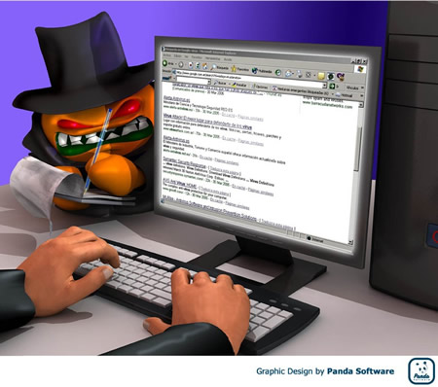
Threats, Attacks, and Vulnerabilities
Session 2
Security+
Malware and Crypto-Malware
Adware – The primary purpose of this software is to display unwanted advertising to your screen and generate revenue for the creator. While the software is not malicious, it is annoying, diverts attention, and takes up computer resources.
Spyware – an application that covertly gathers information about a user’s internet usage and then exploits this information. Activity on the infected computer is reported to the originator without the knowledge of the user. Mostly the information is centered around what websites are visited and what information is clicked on, to forward this information over to marketers to target web site-based ads.

Slide 17
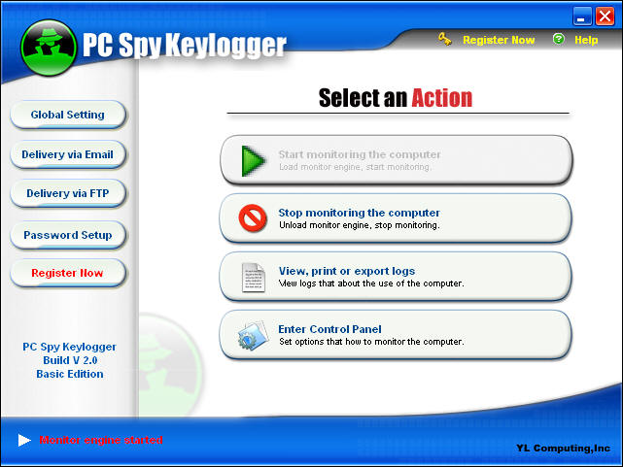
Threats, Attacks, and Vulnerabilities
Session 2
Security+
Malware and Crypto-Malware
Keylogger
A software program that records keystrokes pressed into a log file and then allows the log file to be viewed by the keylogger source.
This would reveal all user id and password information entered into the system and to all web sites.

Slide 18
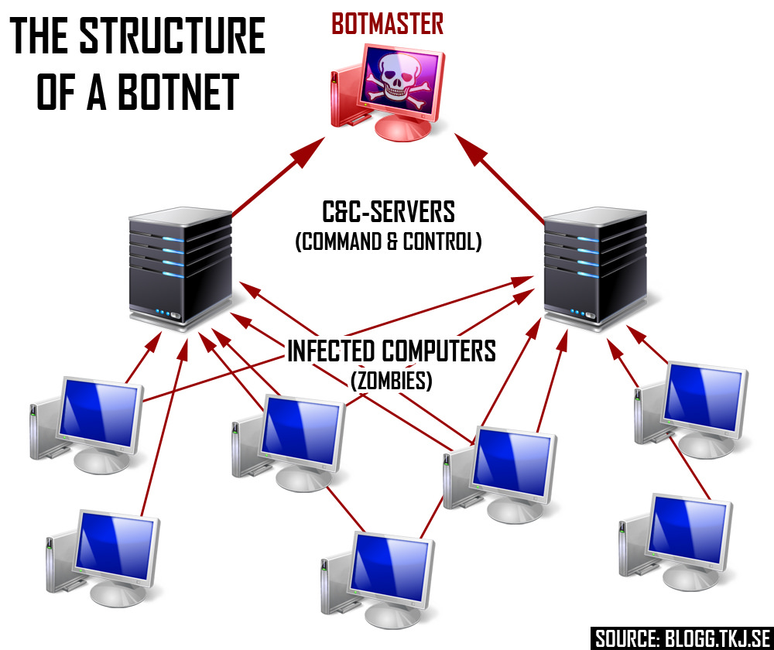
Threats, Attacks, and Vulnerabilities
Session 2
Security+
Malware and Crypto-Malware
Botnets
A collection of computers controlled by a hacker at a command-and-control computer.
Botnets are used in DDoS attacks and as conduits for hackers to attack systems and mask their location. The computers that run as bots are called zombies.

Slide 19
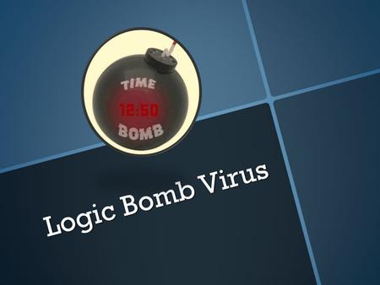
Threats, Attacks, and Vulnerabilities
Session 2
Security+
Malware and Crypto-Malware
RAT – A remote administration tool (RAT) allows a remote user to access the system for the purpose of administering it. These tools can be compromised to allow attackers to remotely administer another computer or application.
Logic Bomb – Programs or code snippets that execute when a certain predefined event occurs. This technique can be used by a virus or worm to execute its payload at a predefined time or when other conditions are met.

Slide 20
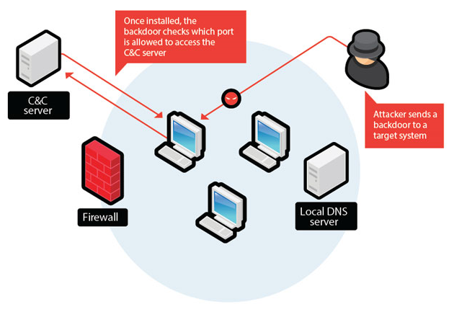
Threats, Attacks, and Vulnerabilities
Session 2
Security+
Malware and Crypto-Malware
Backdoor
This can be an intentional backdoor entrance routine inserted by a programmer to allow access to the applications functions without regular authentication.
Another meaning is for virus programs that create an opening in a system to allow access by an attacker that has planted the backdoor virus program.

Slide 21
Threats, Attacks, and Vulnerabilities
Session 2
Security+
Malware and Crypto-Malware
Knowledge Check 2
A senior incident response manager receives a call about some external IPs communicating with internal computers during off hours.
Which of the following types of malware is MOST likely causing this issue?
A. Botnet
B. Ransomware
C. Polymorphic malware
D. Armored virus

Slide 22
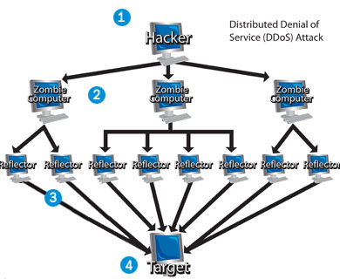
Threats, Attacks, and Vulnerabilities
Session 2
Security+
Types of Application and Service Attacks
Denial of Service (DoS) Attack
An attack on the network website where the website is flooded with requests that the website is unable to process and causes the website to crash.
Distributed Denial of Service (DDoS) – a DoS attack that is launched from multiple computers linked together in a network of controlled computers (botnet).
Amplification
This is part of a DDoS attack where individual requests are sent to a target computer that will generate multiple responses, and thereby amplify the effects of a DDoS attack.

Slide 23
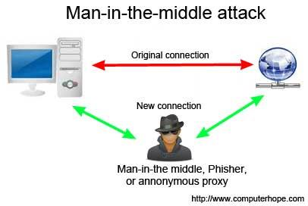
Threats, Attacks, and Vulnerabilities
Session 2
Security+
Types of Application and Service Attacks
Man-in-the-Middle Attack
An attack where the attacker secretly relays and possibly alters the communication between two parties who believe that they are directly communicating with each other and are unaware of the man in the middle eavesdropping on their communication.

Slide 24
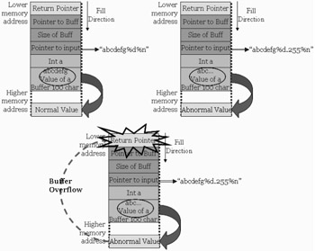
Threats, Attacks, and Vulnerabilities
Session 2
Security+
Types of Application and Service Attacks
Buffer Overflow
Data written to a buffer exceeds the limit of the buffer size.
Programs should do buffer size error checking.
Buffer overflows can crash the system or allow hacker to execute malicious code.

Slide 25
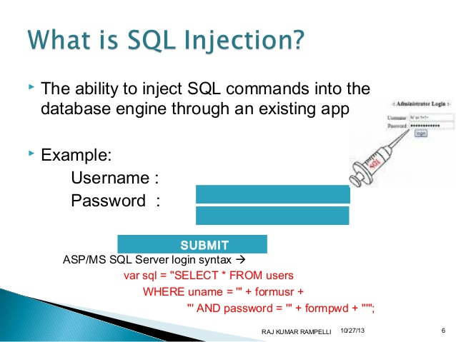
Threats, Attacks, and Vulnerabilities
Session 2
Security+
Types of Application and Service Attacks
SQL Injection Attack
The process of sending malicious SQL queries to the underlying database to manipulate the database for malicious purposes, for example; exfiltration of data.
SQL Injection can be attempted from User Input fields or URL access to web applications.
The way to defend against this type of attack is to always filter the data entered in an input field.

Slide 26
Threats, Attacks, and Vulnerabilities
Session 2
Security+
Types of Application and Service Attacks
LDAP Injection
Lightweight Directory Access Protocol Injection can be used to attack the Active Directory in the same way as SQL Injection attacks a SQL database.
An LDAP query can enter the system through user input and retrieve information from the Active Directory database.
The way to defend against this type of attack is to always filter the data entered in an input field.
XML Injection
A user can input XML through a data input field that can be used by the Xpath XML based engine in a website, and can return documents or information on documents to an attacker.
The way to defend against this type of attack is to always filter the data entered in an input field.

Slide 27
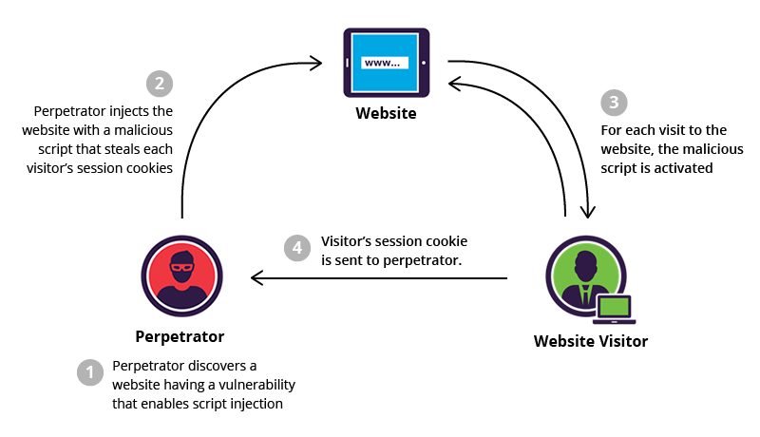
Threats, Attacks, and Vulnerabilities
Session 2
Security+
Types of Application and Service Attacks
Cross-Site Scripting (XSS)
Exploitation of a vulnerability on a website to inject malicious code into a web application.
Using client-side scripting languages such as JavaScript without proper input or output validation on dynamic websites.
Keyword in the malicious script code is “</script>”
Nonpersistent XSS – URL with rogue script.
Persistent XSS – Websites that allow users to input data that is stored in a database or other location.
DOM (Document Object Model) based XSS – local document attacked to modify original page client-side JavaScript.
Example:
Index.php?name=<script>window.onload=function(){var link=document.getElements➔ByTagName(“a”);link[0].href=http://not-real-xssattackexamples.com/;}</script>

Slide 28
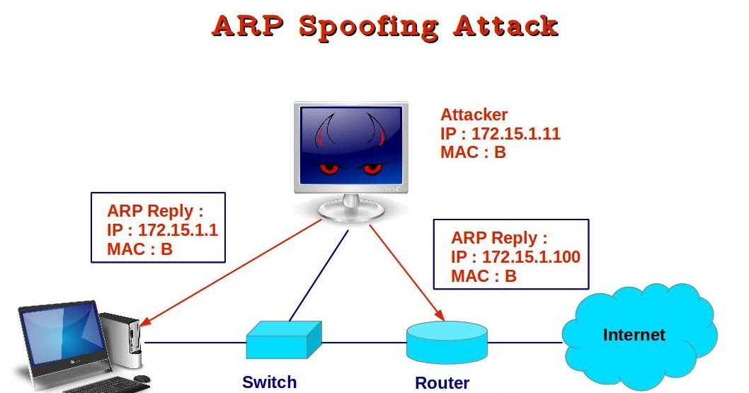
Threats, Attacks, and Vulnerabilities
Session 2
Security+
Types of Application and Service Attacks
ARP Poisoning
The MAC (Media Access Control) address of the data is spoofed. The network data packet then appears to come from a reliable network source when it did not.
The spoofed MAC address packet can fool the switch or router to sending data to an invalid source.
This is an attack at a OSI Layer 2 device.

Slide 29
Threats, Attacks, and Vulnerabilities
Session 2
Security+
Malware and Crypto-Malware
Knowledge Check 3
A web application is configured to target browsers and allow access to bank accounts to siphon money to a foreign account.
This is an example of which of the following attacks?
A. SQL injection
B. Header manipulation
C. Cross-site scripting
D. Flash cookie exploitation

Slide 30
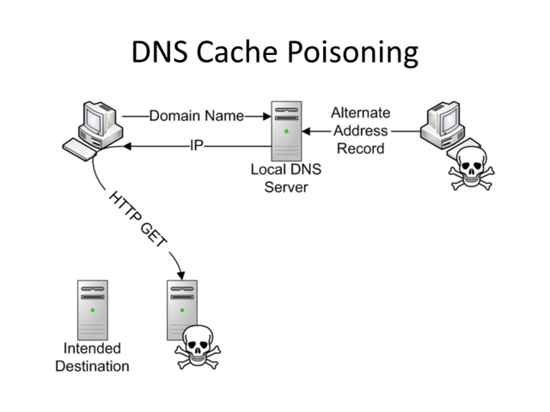
Threats, Attacks, and Vulnerabilities
Session 2
Security+
Types of Application and Service Attacks
DNS Poisoning
In this attack, the DNS, Domain Name Server is poisoned with an invalid name server which will cause DNS to send requests for an IP address or name server to an invalid address.
This could reroute email or any other type of redirection.
Implementing Secure DNS (DNSSEC) can counter DNS Cache Poisoning attacks.

Slide 31
Threats, Attacks, and Vulnerabilities
Session 2
Security+
Types of Application and Service Attacks
Clickjacking
This hijacking attack will attempt to trick a user into clicking a link that says one thing, but the underlying link will go to totally different web page that will attempt to collect information or transmit some malware.
Session Hijacking
This attack begins with capturing the session cookie file that contains all the session data, including authentication, for a web session.
The attacker can then use the session data to authenticate, by impersonating the already authenticated user and establish a valid session with the host server.
Man-in-the-Middle attacks can use session hijacking.
Domain Hijacking
The act of changing the registration information for a domain without the permission of its original registrant. The domain can then be used for phishing, spamming, or any other illegal activity.

Slide 32
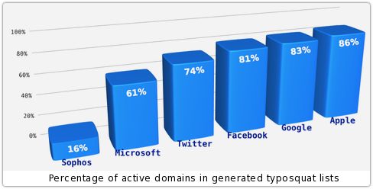
Threats, Attacks, and Vulnerabilities
Session 2
Security+
Types of Application and Service Attacks
Typo Squatting and URL Hijacking
This type of attack is where an attacker will register a domain with a URL that is similar in spelling to a valid domain and set up a website that mimics the original web site.
If someone types in a URL and makes a small spelling error, then they will be taking to the invalid website, and may think that this is a valid site and begin entering information.
For example: RegionsBank.com is a valid banking website. An attacker may set up a website called RegionBank.com and if someone forgets to enter the s in the right place, will be taken to the invalid site and think that they are on their banking web site and begin entering information.

Slide 33
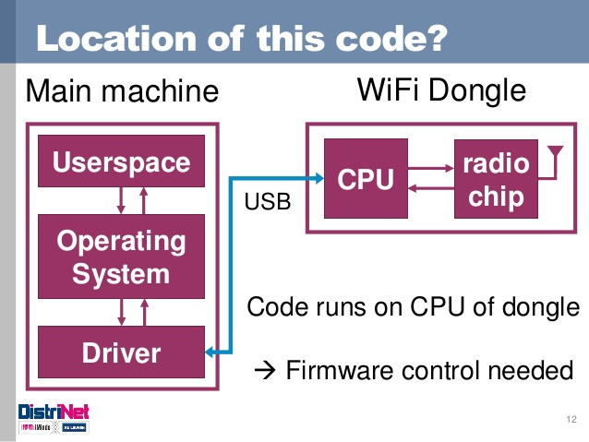
Threats, Attacks, and Vulnerabilities
Session 2
Security+
Types of Application and Service Attacks
Driver Manipulation
Shimming
A small library created to intercept API calls transparently and control the actions of the API. A shim library can intercept the API calls of a driver and cause the actions of the driver to be changed.
Refactoring
Changing an applications source code without modifying its characteristics or its attributes, or its visible behavior.

Slide 34
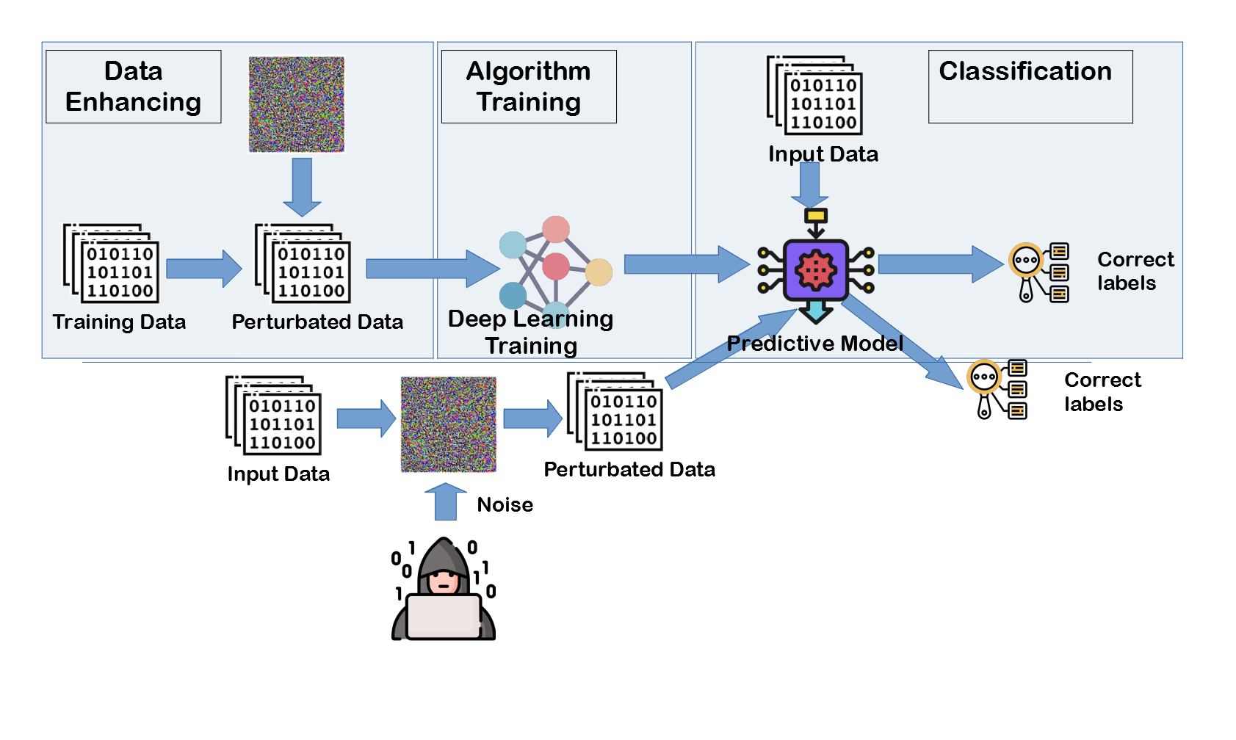
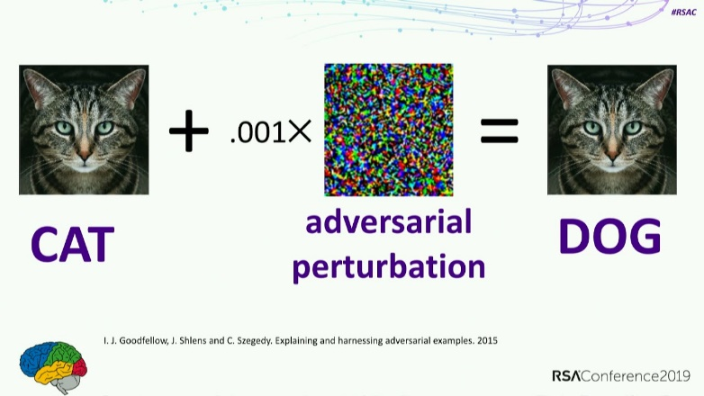
Threats, Attacks, and Vulnerabilities
Session 2
Security+
Types of Application and Service Attacks
Adversarial Artificial Intelligence Attacks
These attacks are on artificial intelligence or machine learning algorithms that controls devices like biometrics and image recognition.
With the insertion of an attacker’s malware perturbation, the AI algorithm is fooled by the design of the attacker.

Slide 35
Threats, Attacks, and Vulnerabilities
Session 2
Security+
Malware and Crypto-Malware
Knowledge Check 4
An attacker uses a network sniffer to capture the packets of a transaction that adds $20 to a gift card. The attacker then user a function of the sniffer to push those packets back onto the network again, adding another $20 to the gift card. This can be done many times.
Which of the following describes this type of attack?
A. Integer overflow attack
B. Smurf attack
C. Replay attack
D. Buffer overflow attack
E. Cross-site scripting attack

Slide 36
Threats, Attacks, and Vulnerabilities
Session 2
Security+
Malware and Crypto-Malware
Knowledge Check 5
A security administrator wants to implement a logon script that will prevent MITM attacks on the local LAN.
Which of the following commands should the security administrator implement within the script to accomplish this task?
A. arp - s 192.168.1.1 00-3a-d1-fa-b1-06
B. dig - x@192.168.1.1 mypc.comptia.com
C. nmap - A - T4 192.168.1.1
D. tcpdump - lnv host 192.168.1.1 or either 00:3a:d1:fa:b1:06

Slide 37
Threats, Attacks, and Vulnerabilities
Session 2
Security+
Malware and Crypto-Malware
Knowledge Check 6
A company’s user lockout policy is enabled after five unsuccessful login attempts. The help desk notices a user is repeatedly locked out over the course of a workweek.
Upon contacting the user, the help desk discovers the user is on vacation and does not have network access.
Which of the following types of attacks are MOST likely occurring? (Select two.)
A. Replay
B. Rainbow tables
C. Brute force
D. Pass the hash
E. Dictionary

Slide 38
Threats, Attacks, and Vulnerabilities
Session 2
Security+
Thank You!!
Send questions and slide deck requests to:
Jim Reeves
Security+, CASP+,CySA+, CISSP, ITILv3, CTT+
MCSE, MCSD, MCT
jireeves@Deloitte.com

